Slide 1

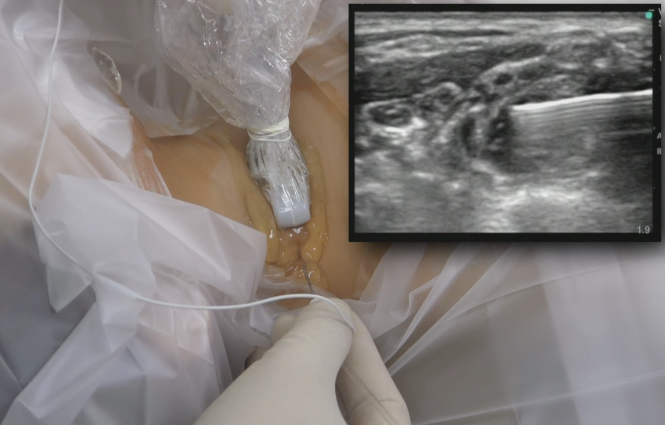
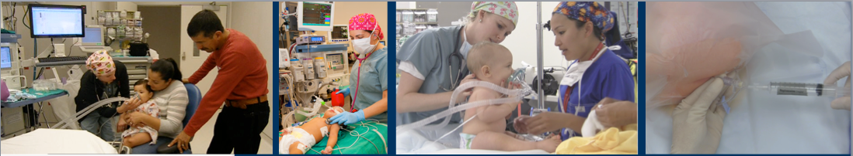
Safe Injection Practices Training for The Department of Pediatric Anesthesiology
February 2016
Pediatric Anesthesiology
Notes:
Text
Text
Text
Text

Slide 2
Learning Objectives
After watching this slideshow, reading Joint Commission documents, and watching the required video, the learner will be able to:
  Explain the need to change injection practices
  Describe the proper steps for ensuring safe injection practices
  Use the information to reduce the potential for injecting microorganisms into patients
  Comply with Joint Commission Standards for Safe Injection Practices

Slide 3
Overview
Why this is important?
Patient Safety Rationale for compliance
4 Key Elements of Compliance
Plan for verification of training via E-Learning

Slide 4
Regulatory
CDC developed and released Safe Injection Practices recommendations in 2007
Joint Commission released a Sentinel Event Alert on preventing infections from the misuse of vials
Infection Control practice is one of the top 10 clinical issues for the Joint Commission in 2016
This is a CMS Standard

Slide 5
Joint Commission Survey Timeline
Mock Survey February 23rd thru 26th
  West Campus February 25th
Joint Commission Survey anticipated in 2017

Slide 6
Recent Audit of Anesthesia Practice
Not wearing gloves to prepare medications
Not scrubbing the diaphragm of ALL vials with alcohol before drawing up medications
Scrubbing but not letting the diaphragm dry before puncturing
Not scrubbing IV ports and stopcocks with alcohol before medication administration

Slide 7
One and Only Campaign
One Needle, One Syringe, Only One Time
Started by the CDC and the Safe Injection Practices Coalition in response to outbreaks of Hepatitis B & C and other BSIs from misuse of vials

Slide 8
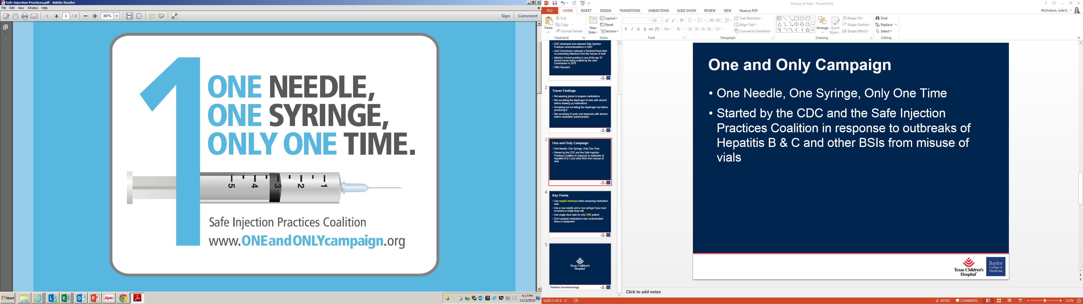

Slide 9
4 keys Steps for Compliance
Safe Hands during Preparation
Clean Vial before aspiration
Clean IV hub before Administration
  15 second scrub and 15 second dry for central lines or I.V.s connected to central lines
Safe Hands during Administration

Slide 10
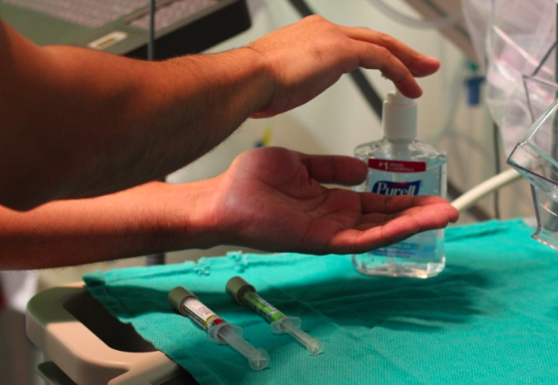
Safe Hands During Preparation

Slide 11
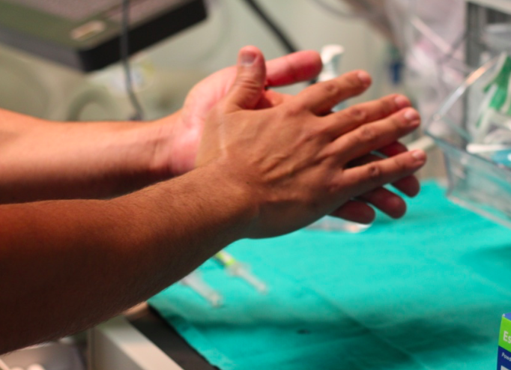
Safe Hands During Preparation

Slide 12
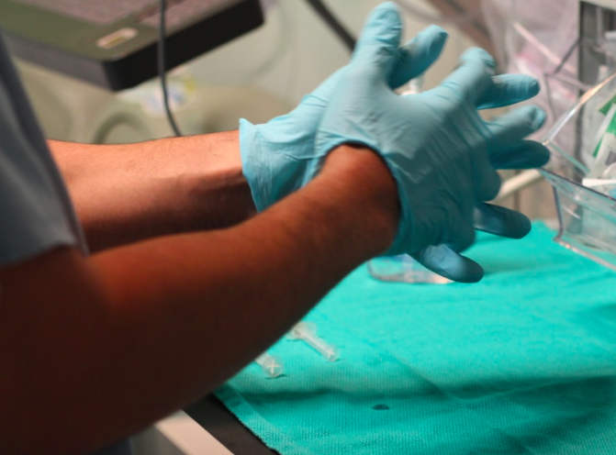
Safe Hands During Preparation

Slide 13
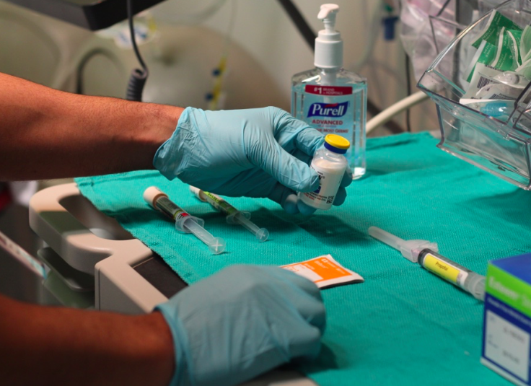
Clean Vial Before Aspiration

Slide 14
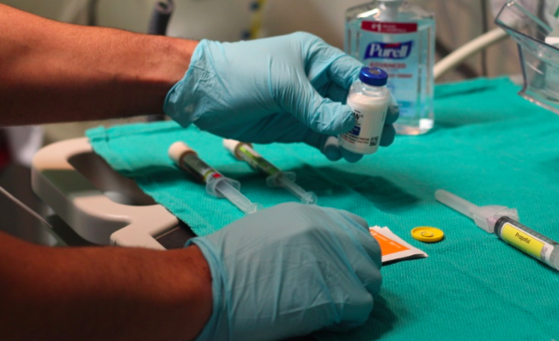
Clean Vial Before Aspiration

Slide 15
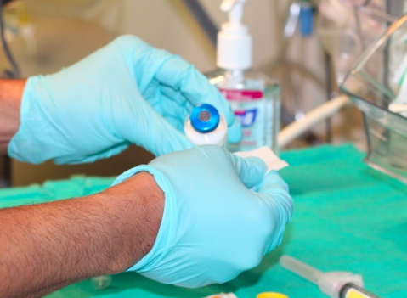
Clean Vial Before Aspiration

Slide 16
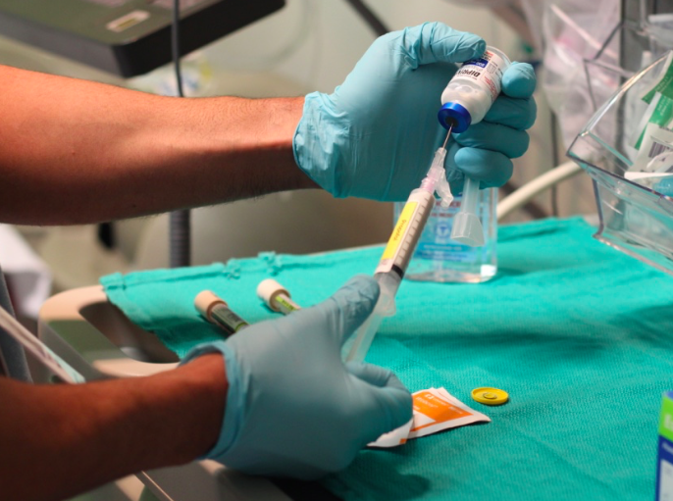
Clean Vial Before Aspiration

Slide 17
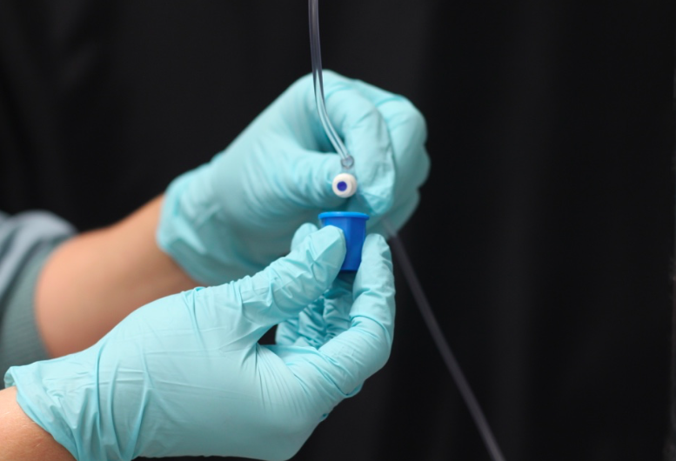
Clean IV Hub Before Administration

Slide 18
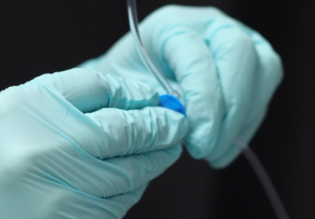
Clean IV Hub Before Administration

Slide 19
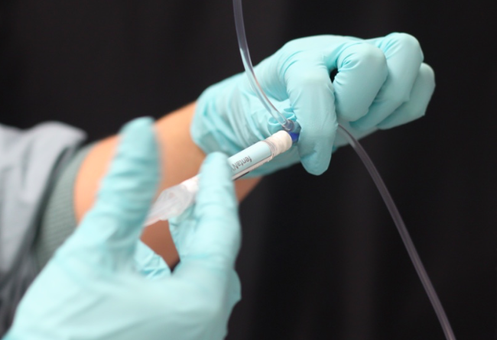
Wear Gloves During Administration

Slide 20
Key Points
Perform hand hygiene and wear gloves during preparation
Wipe diaphragm of ALL vials with alcohol before drawing
Use new needle & new syringe if you re-access a single dose vial
Use single dose vials for only ONE patient
Do not administer medication from the same syringe to multiple patients
Do not use IV fluid bags as a common source of supply for more than 1 patient

Slide 21
E-Learning
Anticipate email from Healthstream.com or Skyprep.com to complete e-training to ensure understanding

Slide 22

Thanks for your dedication to patient safety and compliance with Joint Commission Requirements!

Slide 23
References
Sentinel Event Alert Issue 52, June 16, 2014
  http://www.jointcommission.org/sea_issue_52/
Safe Injection Practices One and Only Campaign
  http://www.oneandonlycampaign.org/content/endorsement-cdc-position-statement-single-dosesingle-use-vials
Care of a Central Venous Catheter (CVC) Procedure
  http://connect2depts.texaschildrens.org/depts/1/nursing/12%20Tower%20General%20Medicine%20and%20Transplant/Education/Documents/Central%20Line%20Management.ppt

Slide 24

Pediatric Anesthesiology

